Slide 1
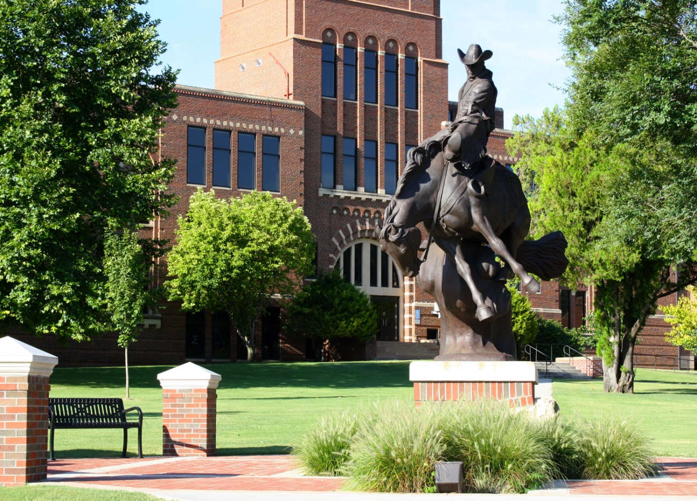
Ranger Nursing
April 2014

Slide 2
Many Happenings since 2012 Meeting
Change in Program Leadership
Addition of Nursing Faculty
Addition of University Center in Ponca City
Larger Class Sizes
Online RN-to-BSN Program
Ongoing OBN Approval
Ongoing Accreditation – ACEN and HLC

Slide 3
Change in Program Leadership
Dr Bo Hannaford – Dean for School of Professional Studies effective July 1, 2012
Dr Shelly Wells – Division Chair effective July 1, 2013
Cheryl Kent – Assistant Chair – Enid Campus
Leslie Collins – Assistant Chair – Alva Campus

Slide 4

Nursing Faculty

Slide 5
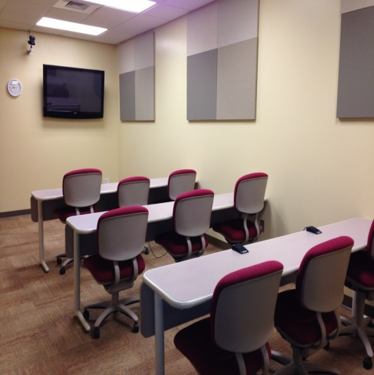
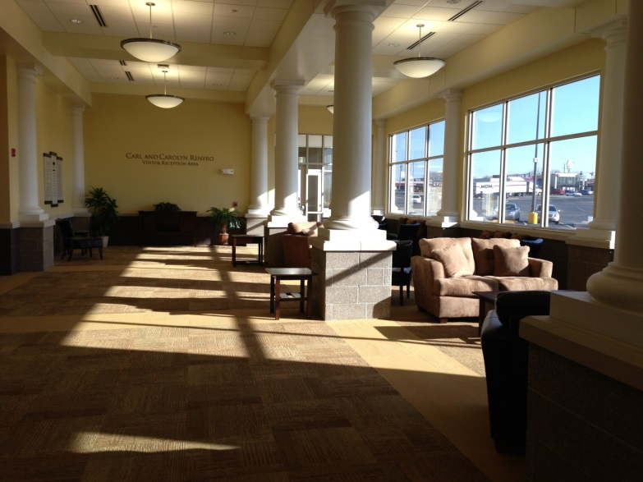
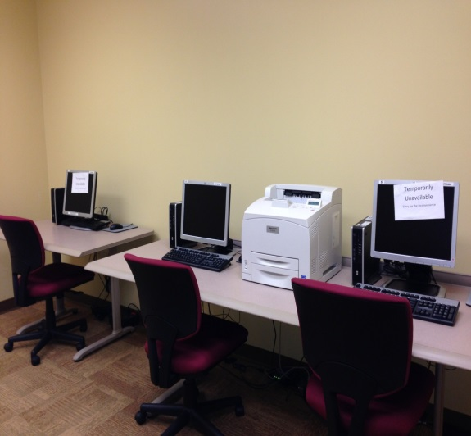
University Center- Ponca City
ITV Site Addition

Slide 6
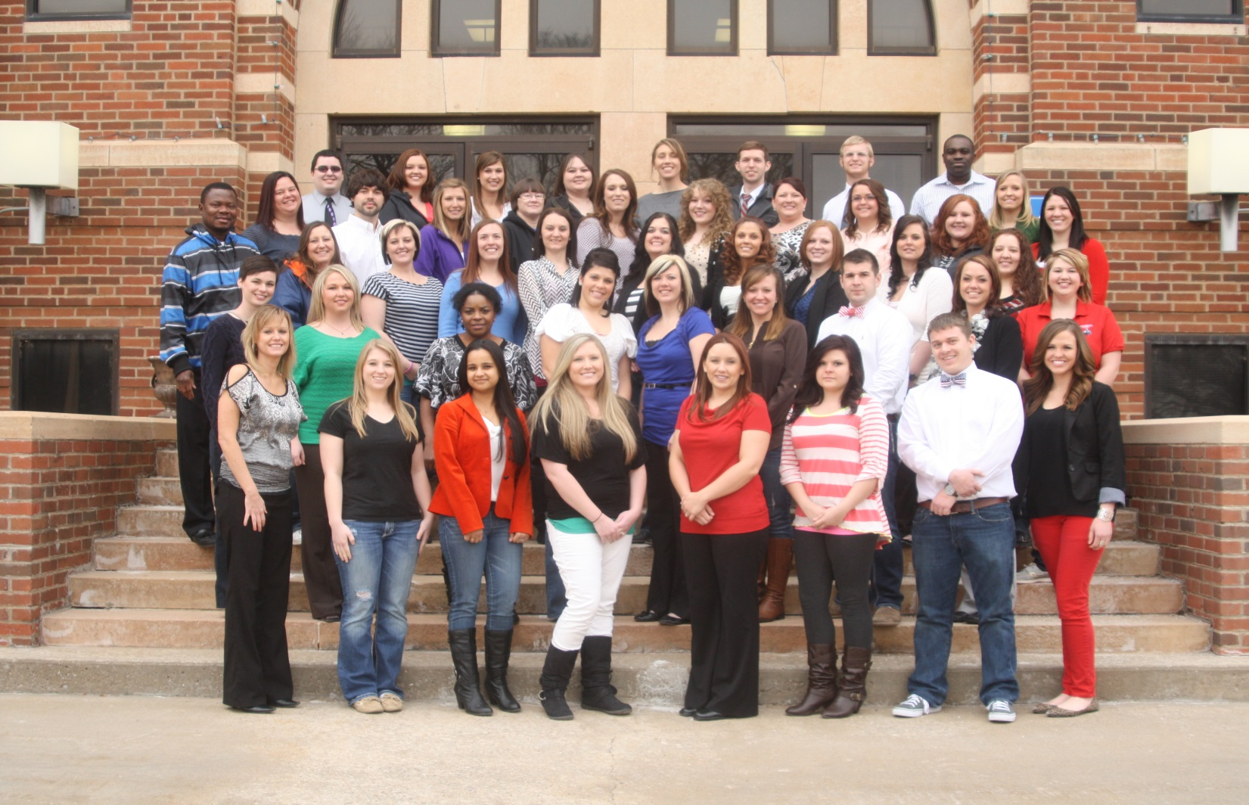
Larger Class Sizes

Slide 7
Admissions
Fall 2012 – Admitted 43
Fall 2013 – Admitted 35
Fall 2014 – Admitting 42 plus 3 returning for a total of 45

Slide 8
Online RN-to-BSN Program
Designed for working RNs. Completed in 12 months.
Pilot cohort of 3 students entered January 2013 and graduated December 2013
Cohort of five students started January 2014

Slide 9
Ongoing OBN Approval
Routine Approval Visit held April 2013
Received continuing approval for 5 more years

Slide 10
Ongoing Accreditation
NLNAC Follow Up Report on Standard 2 October 2013
NLNAC Substantive Change Report for Online Program – January 2013
NLNAC Substantive Change Report for Ponca City ITV addition – April 2013
NLNAC name changes to ACEN (Accreditation Commission for Education in Nursing)
ACEN Focused Site Visit on Substantive Changes – March 2014. Final Report anticipated August 2014

Slide 11
Program Outcomes

Slide 12
Program Outcomes
Student Learning Outcomes
  Measured in each course
  Based upon the ANA Standards, AACN Essentials for Baccalaureate Education in Nursing, IOM Report Recommendations, QSEN Competencies, and the OBN Competencies by Educational Level
  Exceeded benchmarks of 90% satisfaction based upon student survey

Slide 13
First Time NCLEX-RN Pass Rates

Slide 14
Program Outcomes
Program Completion Rate
Graduate Program Satisfaction
Graduate Employment
Employer Satisfaction

Slide 15
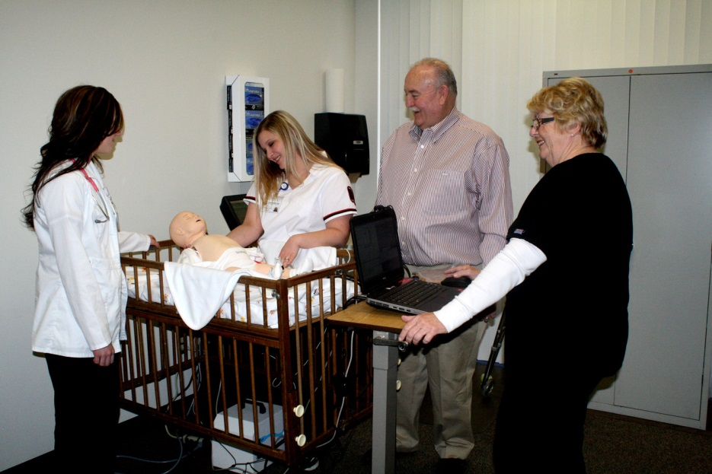
Still to come
Updating of Ketterman Lab in Enid
Development of high fidelity simulation lab at Woodward
Planning for high fidelity simulation lab in Alva
Working with the University Center and Ponca City Medical Center on Lab expansion

Slide 16


